Slide 1
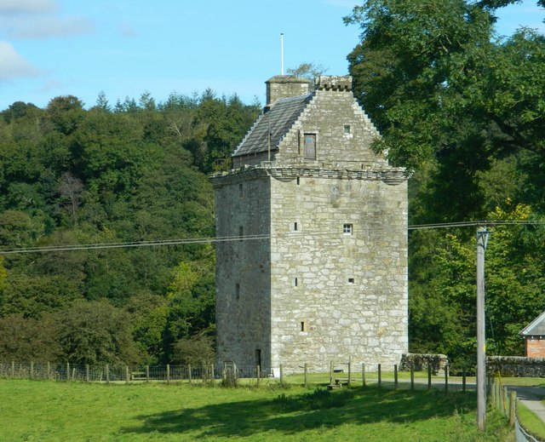
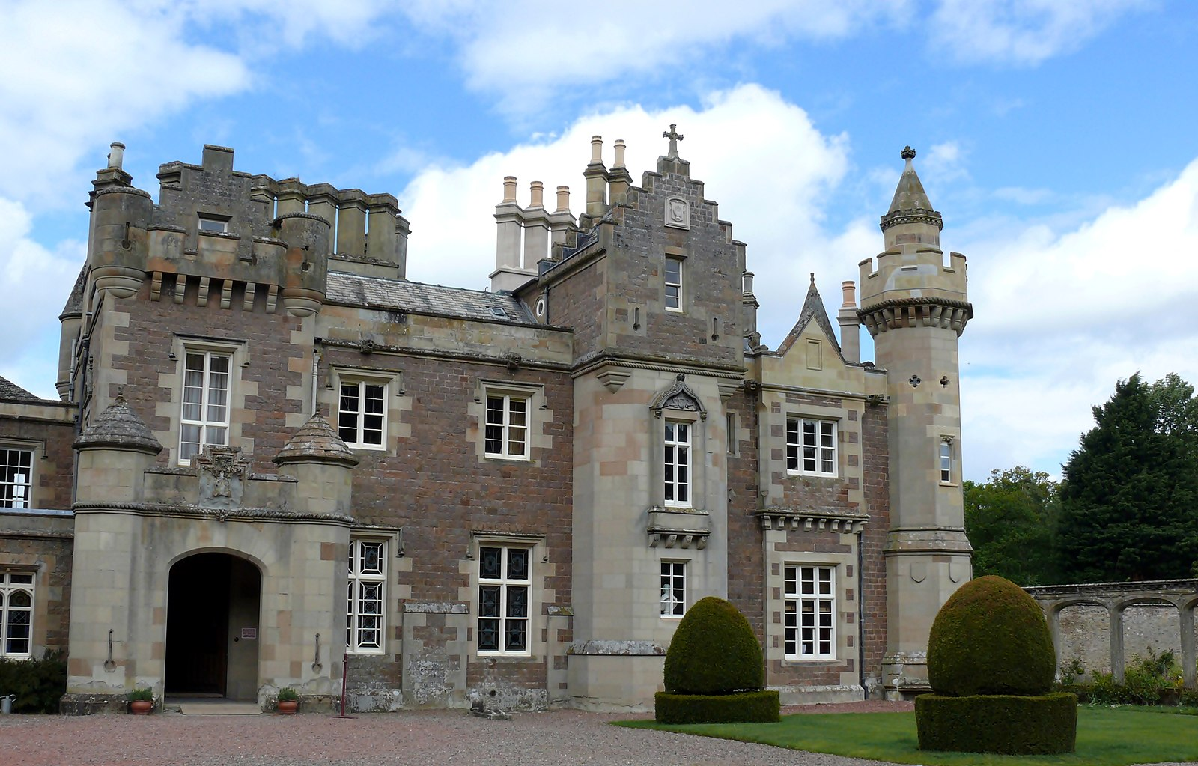
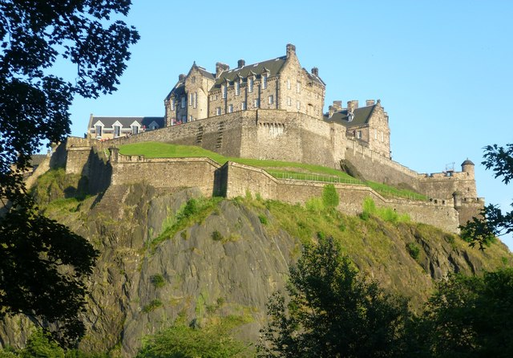
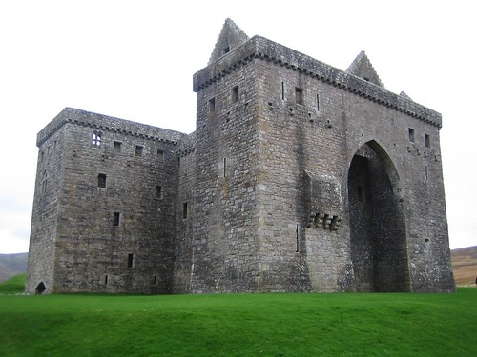
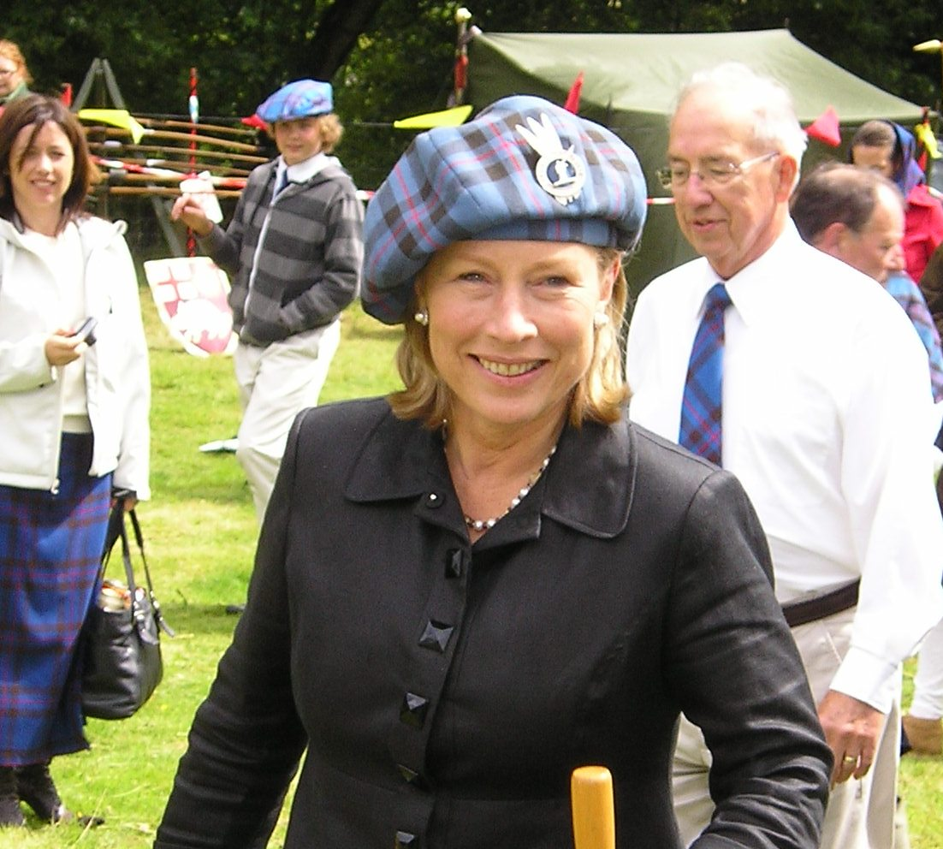
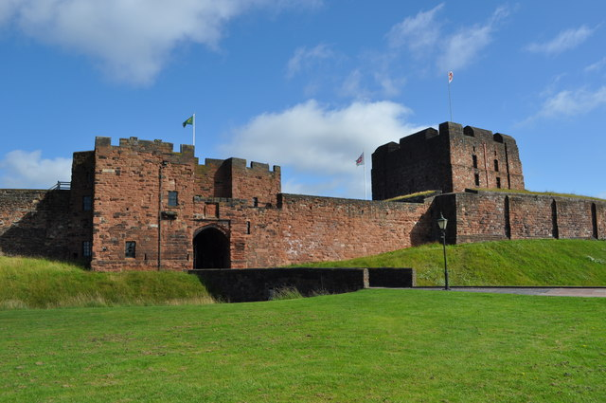
Clan Elliot Gathering 2023 Border Tour
This Photo by Unknown Author is licensed under CC BY-SA
This Photo by Unknown Author is licensed under CC BY-SA

Slide 2
2023 Border Tour Itinerary (Tentative)
Wednesday, 23 August
Arrive Edinburgh and transfer to hotel in Dumfries
Thursday, 24 August
Tour local area: Carlisle Castle, Tullie Museum, Gretna Green
Friday, 25 August
Attend the Elliot Gathering in Newcastleton
Saturday, 26 August
Attend Holm Show in Newcastleton & tour Hermitage Castle

Slide 3
2023 Border Tour Itinerary (Tentative)
Sunday, 27 August
Join the Clan for church service & tour of Caerlaverock Castle & Gilnockie Tower
Monday, 28 August
Journey to Peebles; Visit Abbotsford and Jedburgh or Dryburgh Abbey
Tuesday, 29 August
Free day in Edinburgh
Wednesday, 30 August
Fly home

Slide 4
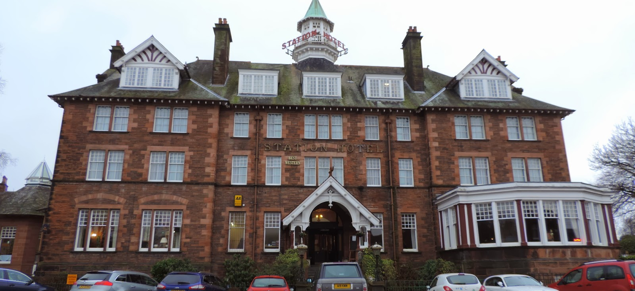
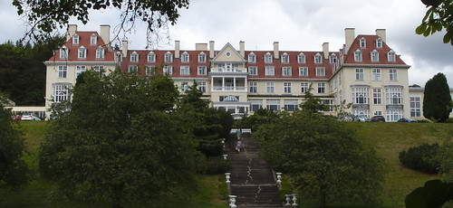
2023 Border Tour Itinerary (Tentative)
Includes
7 nights 4-star hotel accommodations
Holiday Inn, Dumfries
Peebles Hydro Hotel, Peebles
7 breakfasts and 7 dinners
Coach transportation with tour manager/guide
Guided tour of Edinburgh
Entrance fees for above plus Edinburgh Castle
Porterage of 1 piece of luggage per person
Taxes, services charges and fees
This Photo by Unknown Author is licensed under CC BY-ND
This Photo by Unknown Author is licensed under CC BY-NC

Slide 5
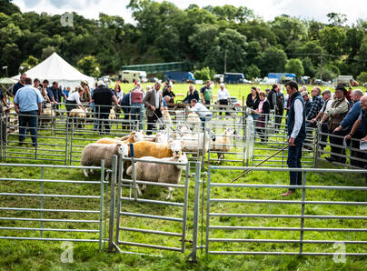
2023 Border Tour Itinerary (Tentative)
Not included
Gratuities for driver and guides
Personal Expenses
Lunches
Clan Gathering tickets
Admission to Holm Show

Slide 6
2023 Border Tour Itinerary (Tentative)
ESTIMATED COST
Per Person $2599 *
Single Supplement $615 *
Airfare (East Coast) $1000+ *
* Subject to change based on fuel charges

Slide 7
Contact Information
www.IsleInnTours.com
703-683-4800 (local) 800-237-9376 (toll free)
info@isleinntours.com
Independent Tours
Andrea Wright
Independent Travel
Andrea@IsleInnTours.Com
Ext: 1005
Group Tours
Fiona Lydon
Group Travel Manager Fiona@IsleInnTours.Com
Ext: 1003

Slide 8
Destination Specialists
Experience
Tips and Advice
Knowledge
Where to go and what to see
Clout with travel and tour companies
Can often get what the private traveler can’t get
Negotiate or arrange special amenities
Cost-Savings
Group rates on hotels and attractions
Time-Savings
Safety Net /Trouble shooting
Intercede with hotel or car rental agency
Make alternate travel arrangements in an emergency

Slide 9
VERN & CHRISTI ELLIOTT
Chief Fun Officers
A Veteran Owned, Independent Agent of Cruise Planners, Specializing in European Travel
813-445-8300

Slide 10
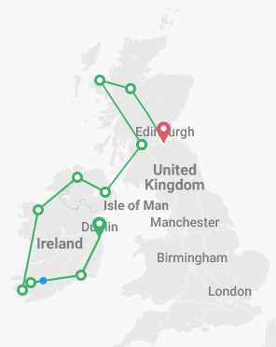
SCOTLAND/IRELAND 08/2023
Royal Edinburgh Military Tattoo
Scotch Whisky Experience
Loch Ness/Isle of Skye
Belfast Titanic Experience
Giant’s Causeway
Galway
Guinness/Jameson Tour
So much more….
PLEASE REACH OUT IF INTERESTED!

